Slide 1

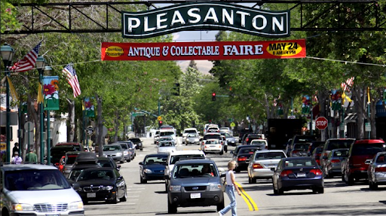


Pleasanton Transportation Safety Action Plan (PTSAP)
Community Meeting #3
April 21, 2026
6:00 PM

Slide 2
Introductions
City of Pleasanton
Mike Tassano, Deputy Director of Community and Economic Development
Cedric Novenario, Senior Transportation Engineer
TJKM Transportation Consultants
Ruta Jariwala, Principal & Project Manager
Rutvij Patel, Senior Transportation Engineer
Grishma Pandya, Transportation Planner

Slide 3
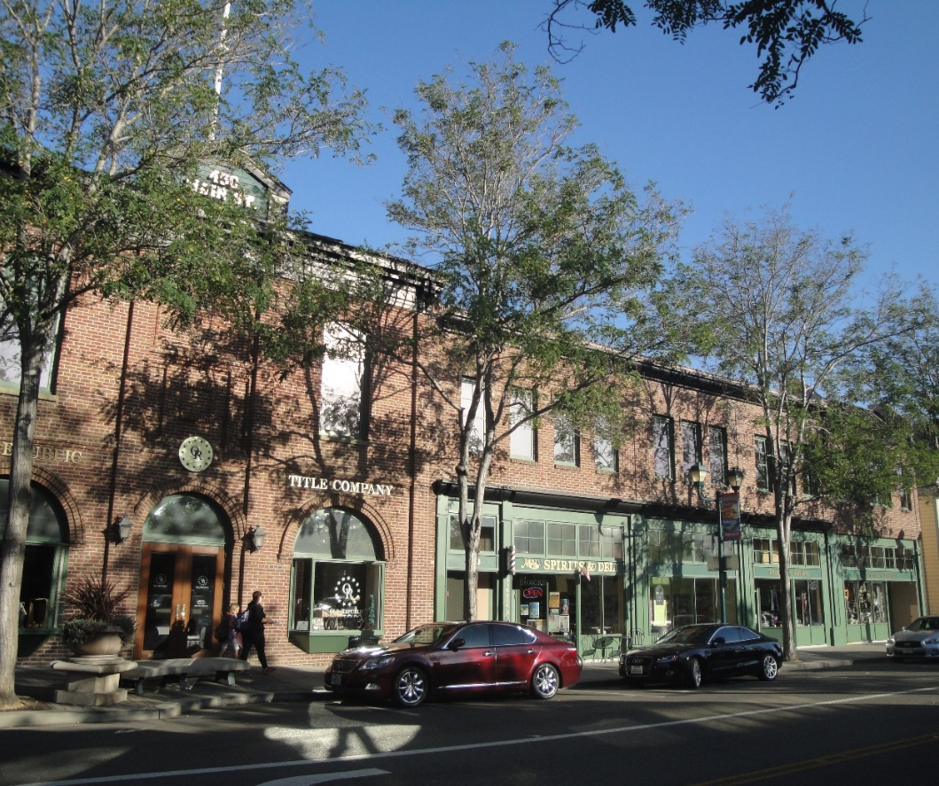
Agenda
What is a Pleasanton Transportation Safety Action Plan (PTSAP)
PTSAP Process
Collision Analysis Findings
High Injury Network & Focused Corridors
Response through Interactive Map
Safety Countermeasures
Safety Projects
Your Role as a Safety Champion
Next Steps
Discussion/Questions

Slide 4
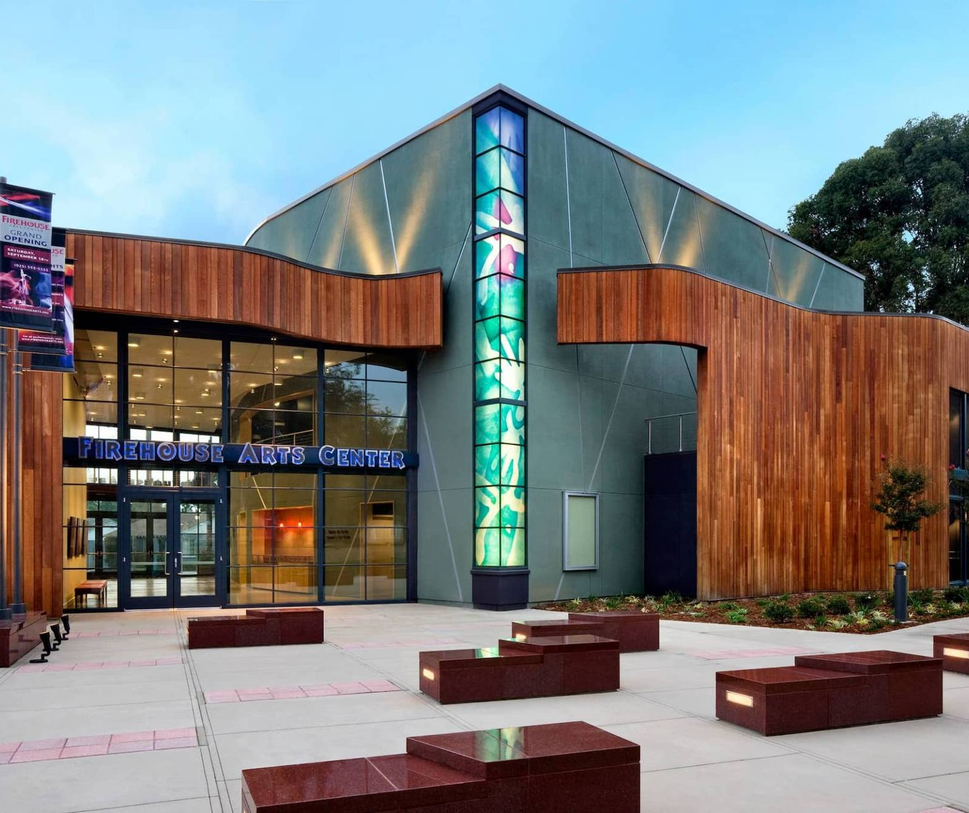
What is a Pleasanton Transportation Safety Action Plan (PTSAP)?
The City of Pleasanton is developing a PTSAP, funded by the U.S. Department of Transportation (USDOT) Safe Streets and Roads for All (SS4A) grant program, to improve safety on roadway network.
Guiding Principles:
Prioritize human life over speed, convenience, or property in all street design decisions;
Recognize traffic deaths and severe injuries as preventable;
Design roadways to account for human error;
Promote slower speeds to create safer roadways for all users;
Expand safe transportation options for walking, biking, and motorcyclists;
Address collision risks proactively and reactively using both data and risk assessments;
Advance roadway safety equitably using data-driven strategies and enforcement;
Implement proven and innovative strategies, with ongoing monitoring and clear public communication;
Ultimate goal to eliminate all traffic-related fatalities and serious injuries, with a commitment to making roads, vehicles, and traffic systems as safe as possible for all users.

Slide 5
PTSAP Process
Stakeholder & Community Input
July 2025
Project Kick-off
Data Collection
5 years
(2020-2024)
Collision Trend Analysis/Need Analysis
Identification of High-Risk Network
Develop Safety Countermeasures
Stakeholder Input
Only Killed & Severe Injury Collisions
Highest number of fatal and severe injury collisions
PTSAP Final
Draft Plan
Integrate Plan
& Prioritize Improvements
We are here in the process
City Council Adoption
Stakeholder & Community Input

Slide 6
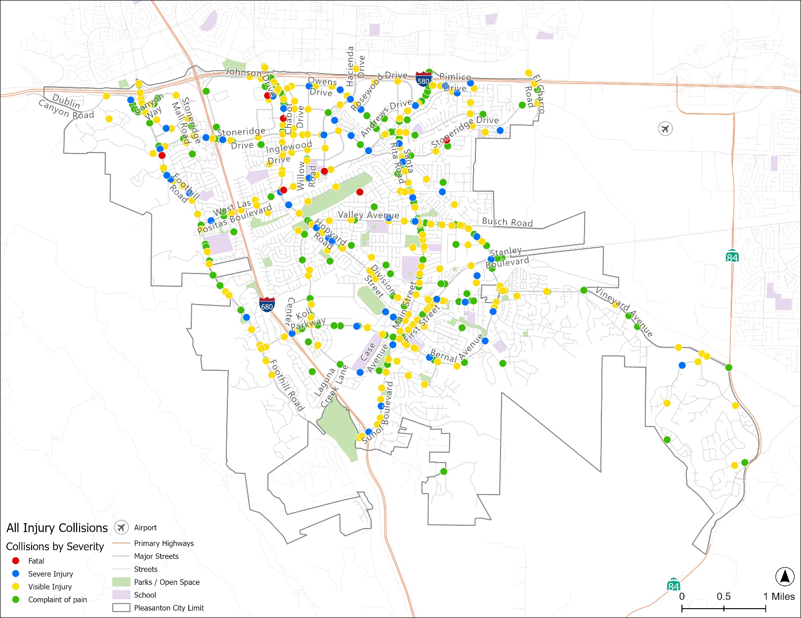
Collision Analysis Findings (2020–2024)
Collision Severity | Roadway/ Corridor | Intersection | Total
Fatal | 2 | 5 | 7
Severe Injury | 14 | 46 | 60
Visible Injury | 67 | 260 | 327
Complaint of Pain | 59 | 356 | 415
Total | 142 | 667 | 809
*Note - Collision data on Caltrans maintained facilities (I-580 and I-680) were not considered as part of this analysis.
All Injury Collisions (2020-2024)
Notes:
All Injury Collisions and KSI

Slide 7
High Injury Network - Corridors
ID | Corridors | Fatal | Severe Injury | Visible Injury | Complaint of Pain | KSI Collisions | Injury Collisions | At Intersection | Pedestrian Collisions | Bicycle Collision | Length (miles)
A | Hopyard Road: I-580 to Del Valle Pkwy | 1 | 7 | 27 | 41 | 8 | 76 | 67 | 3 | 14 | 9.98
B | Santa Rita Road: I-580 to Del Valle Pkwy | 0 | 4 | 31 | 54 | 4 | 89 | 68 | 3 | 18 | 9.10
C | Stoneridge Drive: Foothill Road to El Charro Road | 1 | 4 | 28 | 42 | 5 | 75 | 69 | 3 | 8 | 8.02
D | Foothill Road: I-580 to Golden Eagle Way | 1 | 5 | 30 | 29 | 6 | 65 | 52 | 3 | 8 | 7.73
E | Bernal Avenue: Foothill Road to Vineyard Avenue | 0 | 5 | 23 | 34 | 5 | 62 | 47 | 5 | 11 | 7.50
F | Valley Avenue: Sunol Boulevard to Vineyard Avenue | 0 | 2 | 22 | 32 | 2 | 56 | 45 | 4 | 14 | 6.27
G | Owens Drive: Johnson Drive to W Las Positas Boulevard | 0 | 5 | 13 | 21 | 5 | 39 | 31 | 4 | 10 | 6.02
H | W Las Positas Boulevard: Foothill Road to Boardwalk Street | 1 | 3 | 18 | 14 | 4 | 36 | 27 | 0 | 12 | 5.29
I | Sunol Boulevard: Bernal Avenue to I-680 | 0 | 4 | 16 | 26 | 4 | 46 | 41 | 0 | 3 | 4.77
J | Hacienda Drive: I-580 to W Las Positas Boulevard | 1 | 3 | 6 | 9 | 4 | 19 | 18 | 2 | 0 | 3.10
Notes:
Sliding window method:

Slide 8
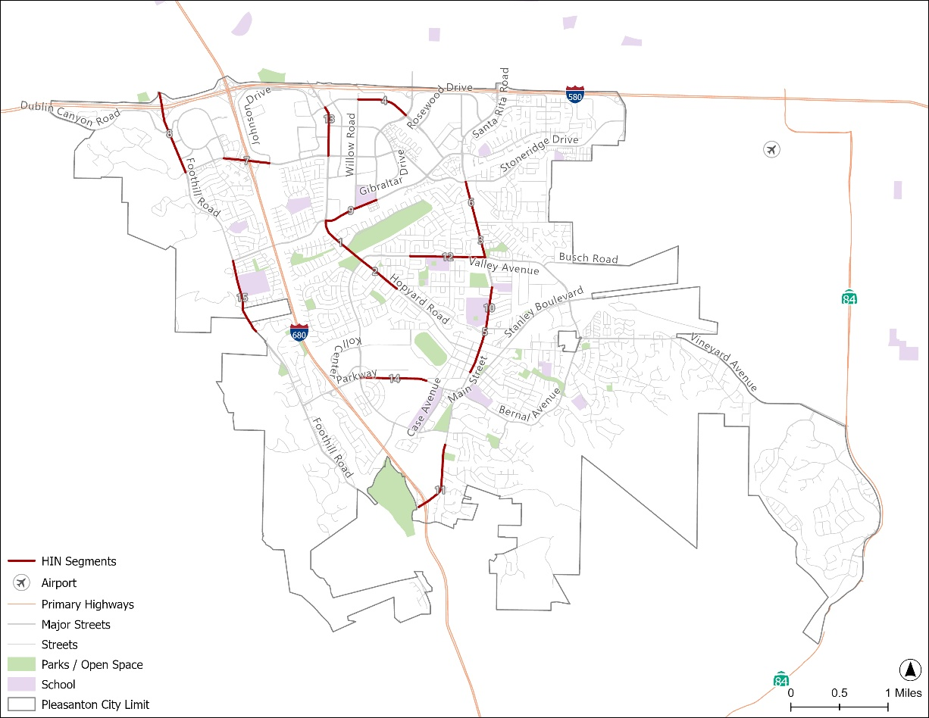
High Injury Network – Focused Corridors
Rank | Corridor | KSI | Injury | Ped | Bike | Unsafe Speed | Score
1 | Hopyard Road: Valley Avenue to West Las Positas Boulevard | 2 | 26 | 1 | 6 | 6 | 58.41
2 | Hopyard Road: Valley Avenue to Black Avenue | 4 | 11 | 3 | 2 | 1 | 49.23
3 | Santa Rita Road: Valley Avenue to Mohr Avenue | 1 | 16 | 1 | 5 | 5 | 44.86
4 | Owens Drive: Willow Road to Hacienda Drive | 3 | 10 | 0 | 5 | 3 | 40.58
5 | Main Streets: Stanley Boulevard to W Angela Street | 0 | 13 | 3 | 3 | 1 | 40.53
6 | Santa Rita Road: Mohr Avenue to Stoneridge Drive | 1 | 17 | 0 | 3 | 7 | 40.12
7 | Stoneridge Drive: Stoneridge Mall Road to Johnson Drive | 2 | 23 | 0 | 3 | 5 | 39.65
8 | Foothill Road: Stoneridge Drive to northern city limit | 0 | 30 | 2 | 0 | 5 | 38.65
9 | West Las Positas Boulevard: Hopyard Road to Hacienda Drive | 3 | 8 | 0 | 2 | 2 | 38.45
10 | Santa Rita Road: Stanley Boulevard to Black Avenue | 0 | 12 | 1 | 5 | 2 | 38.39
11 | Sunol Boulevard: I-680 to Sonoma Drive | 3 | 39 | 0 | 1 | 3 | 37.27
12 | Valley Avenue: Crestline Road to Santa Rita Road | 1 | 9 | 1 | 1 | 4 | 37.18
13 | Hopyard Road: Stoneridge Drive to Owens Drive | 2 | 19 | 0 | 0 | 7 | 37.04
14 | Bernal Avenue: Valley Avenue to Pleasanton Avenue | 1 | 11 | 1 | 1 | 5 | 36.89
15 | Foothill Road: Foothill Knolls Drive to West Las Positas Boulevard | 0 | 10 | 1 | 1 | 5 | 36.85
Criteria | Points
Proximity to Schools | 10
Number of KSI collisions | 20
Number of Pedestrian Collisions | 15
Number of Bicycle Collisions | 15
Number of Collisions due to Unsafe Speed | 20
Collisions Per Miles | 10
Collisions per 1000 AADT | 10
Notes:
Sliding window method:

Slide 9
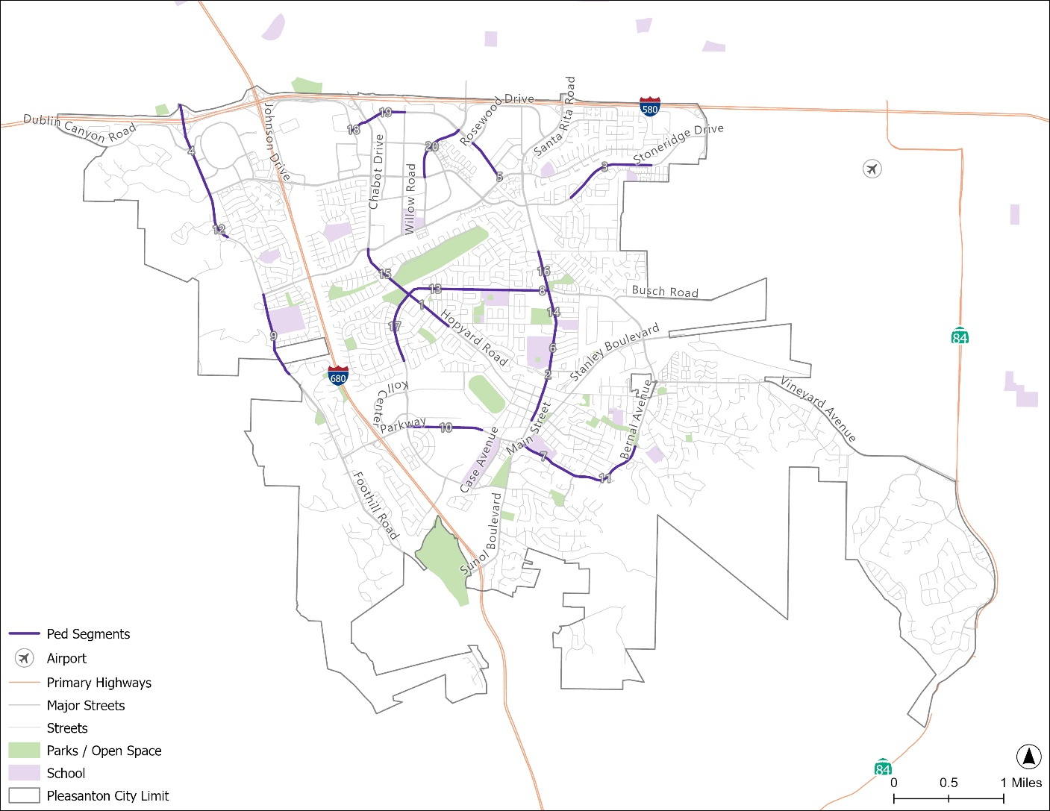
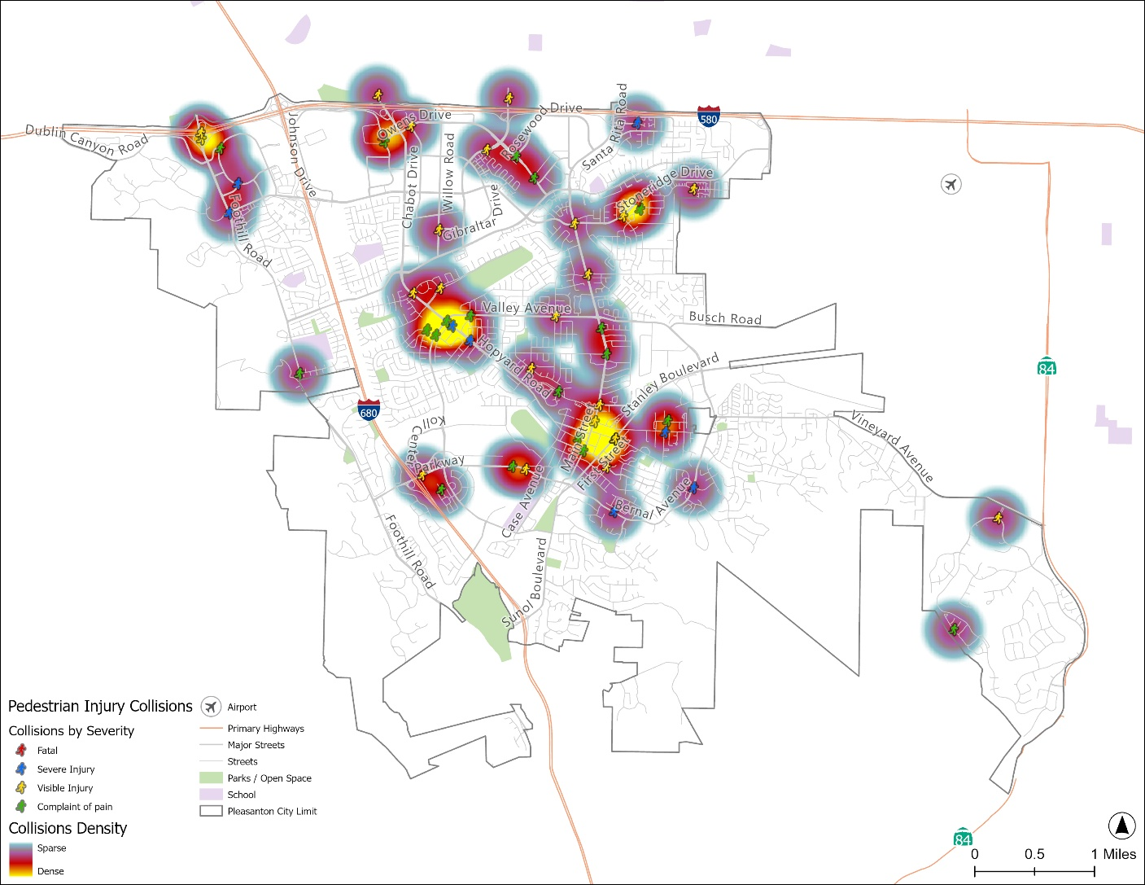
High Injury Network – Pedestrian Focused Corridors
Pedestrian Focused Corridors
Heat Map- Pedestrian Focused Areas
Notes:
Sliding window method:

Slide 10
High Injury Network – Pedestrian Focused Corridors
Rank | Corridor | KSI | Injury | Score
1 | Hopyard Road: Valley Avenue to Black Avenue | 2 | 3 | 40.65
2 | Main Streets: Stanleys Boulevard to W Angela Street | 0 | 3 | 38.89
3 | Stoneridge Drive: Kamp Drive to Trevor Parkway | 1 | 2 | 37.41
4 | Foothill Road: Stoneridge Drive to northern city limit | 0 | 2 | 30.83
5 | Owens Drive: West Las Positas Boulevard to Rosewood Drive | 0 | 2 | 25.22
6 | Santa Rita Road: Stanley Boulevard to Black Avenue | 0 | 1 | 21.80
7 | Bernal Avenue: First Street to Windmill Lane | 1 | 1 | 21.19
8 | Valley Avenue: Crestline Road to Santa Rita Road | 0 | 1 | 20.86
9 | Foothill Road: Foothill Knolls Drive to West Las Positas Boulevard | 0 | 1 | 20.83
10 | Bernal Avenue: Valley Avenue to Pleasanton Avenue | 0 | 2 | 20.66
11 | Bernal Avenue: Windmill Lane to Kottinger Drive | 1 | 1 | 20.65
12 | Foothill Road: Muirwood Drive (north) to Stoneridge Drive | 1 | 1 | 17.50
13 | Valley Avenue: Hopyard Road to Crestline Road | 0 | 1 | 17.25
14 | Santa Rita Road: Black Avenue to Valley Avenue | 0 | 1 | 16.53
15 | Hopyard Road: Valley Avenue to West Las Positas Boulevard | 0 | 1 | 16.44
16 | Santa Rita Road: Valley Avenue to Mohr Avenue | 0 | 1 | 15.79
17 | Valley Avenue: South Paseo Santa Cruz to Hopyard Road | 0 | 1 | 15.52
18 | Owens Drive: Hopyard Road to Johnson Drive | 0 | 1 | 12.41
19 | Owens Drive: Hopyard Road to Willow Road | 0 | 1 | 11.90
20 | Hacienda Drive: Stoneridge Drive to Owens Drive | 0 | 1 | 11.67
Criteria | Points
Pedestrian Fatal Collisions | 20
Pedestrian Severe Injury Collisions | 20
Pedestrian Visible Injury Collisions | 15
Pedestrian Complaint of Pain Collisions | 15
Collision per 1000 AADT | 15
Proximity to School | 5
Proximity to Parks | 5
Proximity to Transit | 5
Notes:
Sliding window method:

Slide 11
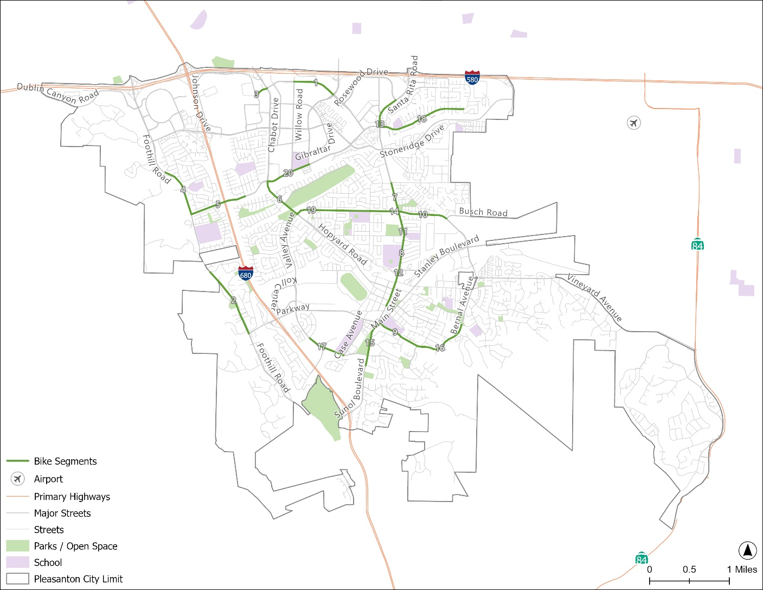
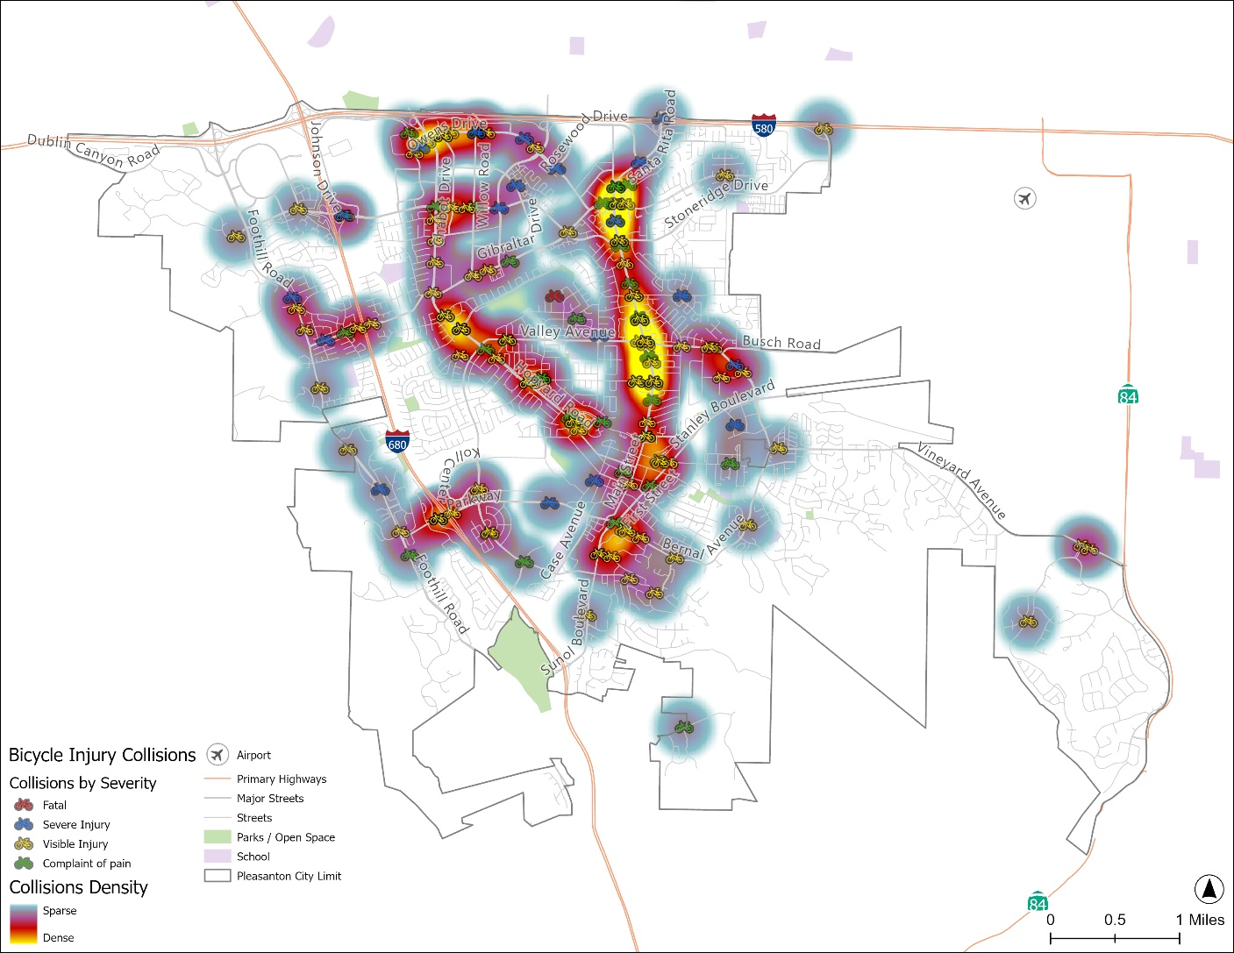
High Injury Network – Bicycle Focused Corridors
Bicycle Focused Segments
Heat Map- Bicycle Focused Segments
Notes:
Sliding window method:

Slide 12
High Injury Network – Bicycle Focused Corridors
Rank | Corridor | KSI | Injury | Score
1 | Owens Drive: Willow Road to Hacienda Drive | 2 | 5 | 50.30
2 | Foothill Road: Bernal Avenue to Foothill Knolls Drive | 1 | 3 | 46.10
3 | Owens Drive: Hopyard Road to Johnson Drive | 1 | 3 | 44.82
4 | Foothill Road: West Las Positas Boulevard to Muirwood Drive (north) | 1 | 3 | 43.58
5 | West Las Positas Boulevard: Foothill Road to Payne Road | 1 | 4 | 39.43
6 | Hopyard Road: Valley Avenue to West Las Positas Boulevard | 0 | 6 | 38.02
7 | Santa Rita Road: Valley Avenue to Mohr Avenue | 0 | 5 | 37.84
8 | Santa Rita Road: Stanley Boulevard to Black Avenue | 0 | 5 | 37.27
9 | Bernal Avenue: First Street to Windmill Lane | 0 | 3 | 35.69
10 | Valley Avenue: Santa Rita Road to Busch Road | 0 | 5 | 35.41
11 | Santa Rita Road: Black Avenue to Valley Avenue | 0 | 3 | 35.15
12 | Main Streets: Stanley Boulevard to W Angela Street | 0 | 3 | 34.65
13 | Santa Rita Road: West Las Positas Boulevard to Rosewood Drive | 1 | 3 | 33.47
14 | Valley Avenue: Crestline Road to Santa Rita Road | 0 | 1 | 31.72
15 | Sunol Boulevard: Sonoma Drive to Bernal Avenue | 0 | 3 | 30.77
16 | Bernal Avenue: Windmill Lane to Kottinger Drive | 0 | 2 | 28.80
17 | Valley Avenue: Oak Vista Way to Case Avenue | 0 | 1 | 28.64
18 | West Las Positas Boulevard: Santa Rita Road to Boardwalk Street | 0 | 4 | 28.38
19 | Valley Avenue: Hopyard Road to Crestline Road | 0 | 2 | 27.53
20 | Owens Drive: Willow Road to Hacienda Drive | 0 | 2 | 24.53
Criteria | Points
Bicycle KSI Collisions | 30
Bicycle Collisions Per Miles Points | 20
Proximity to School | 15
Collision per 1000 AADT | 15
Proximity to Parks | 15
Proximity to Transit | 5
Notes:
Sliding window method:

Slide 13
Identified Collision Profiles
Intersection Collisions
(667)
Broadside Collisions
(329)
Unsafe Speed Collisions
(197)
Traffic Signs and Signal Violation Collisions (156)
Bicycle Collisions
(129)
Improper Turning Collisions
(108)
DUI Collisions
(55)
Pedestrian Collisions
(50)
Notes:
Sliding window method:

Slide 14
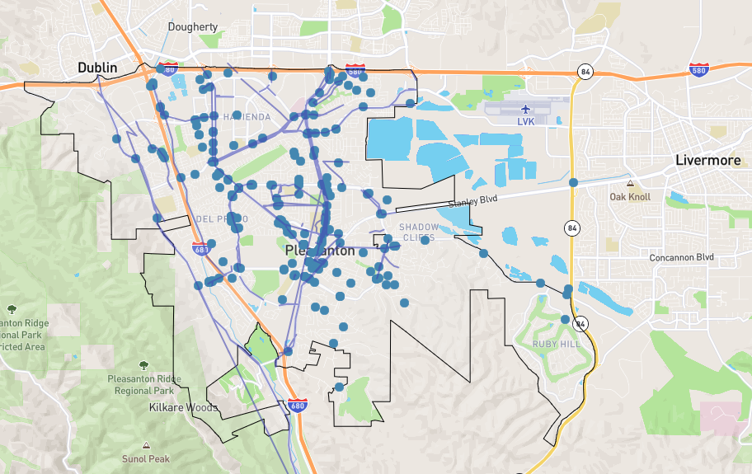
Interactive Map Input Summary
The City of Pleasanton kept its interactive map and survey open through the end of January 2026, providing the public with an opportunity to share their comments and input. This tool played a critical role in gathering and understanding the perspectives of residents.
It allowed community members to conveniently share concerns virtually, without the need to attend in-person meetings.
This interactive approach helped the City develop a more robust, data-driven plan by incorporating community insights that may not be captured through traditional data sources, such as unreported collisions or near-miss experiences.
Residents, with their firsthand knowledge of neighborhood conditions, contributed valuable context that strengthened the overall planning effort.
This reflects a meaningful and proactive effort by the City to engage the community and build a more informed and inclusive plan. A total of 184 respondents participated, identifying 251 exact locations and 103 corridor locations.
Notes:
Rosanna
Project Website is on the City of Arcata and provides information on the progress of the Plans and links to the interactive map and survey.
We have an interactive map which we will do a quick demonstration of later, where you can put comments on a specific location, and a Survey we’d like you all to take that asks about your travel in Arcata and improvements you’d like to see.

Slide 15
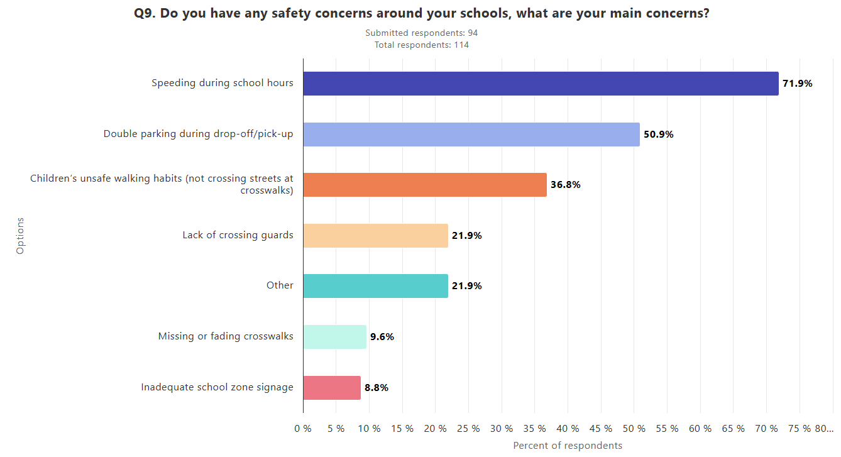
Interactive Map Input Summary
The responses highlight a strong community concern around traffic safety, with recurring issues such as speeding, red-light running, and lack of enforcement appearing across multiple comments.
Many residents also emphasized the need for better infrastructure, including protected bike lanes, improved crosswalks, and safer intersections, particularly near schools and high-traffic areas. Overall, the feedback suggests that a combination of stricter enforcement, infrastructure improvements, and public education is essential to improve safety for all road users.
Notes:
Rosanna
Project Website is on the City of Arcata and provides information on the progress of the Plans and links to the interactive map and survey.
We have an interactive map which we will do a quick demonstration of later, where you can put comments on a specific location, and a Survey we’d like you all to take that asks about your travel in Arcata and improvements you’d like to see.

Slide 16
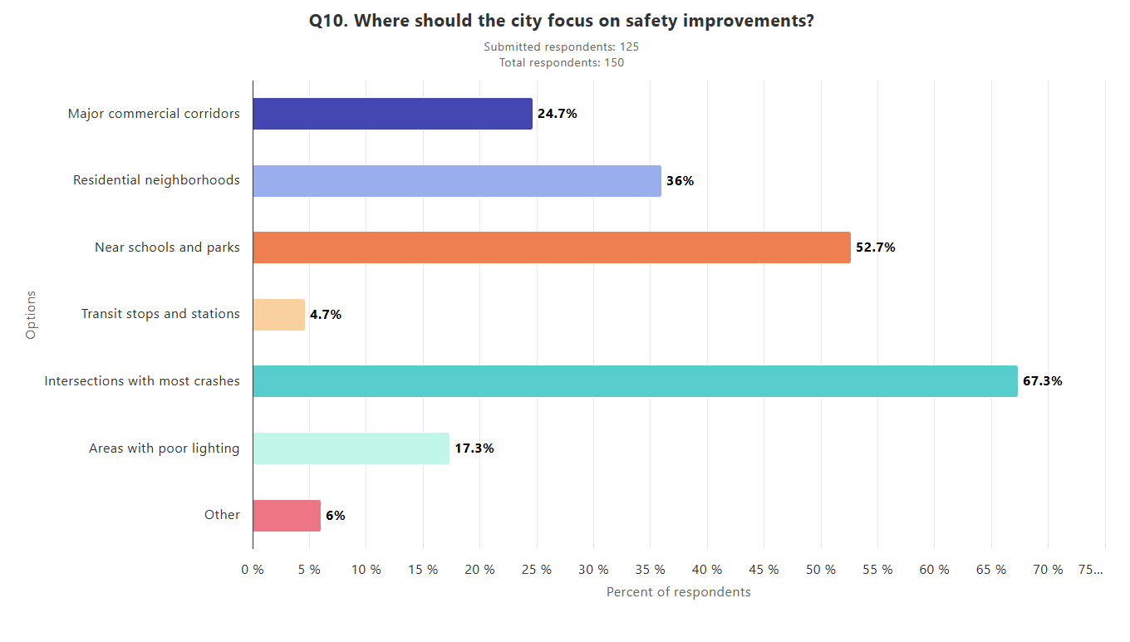
Interactive Map Input Summary
The community-identified locations are primarily concentrated along high-injury corridors, with a strong emphasis on pedestrian and bicycle safety improvements rather than solely speeding-related concerns.
These patterns indicate that residents are most affected by gaps in safe crossings, bike infrastructure, and overall multimodal accessibility. As a result, the proposed safety projects are appropriately focused on addressing these high-priority corridors through targeted pedestrian and bicycle improvements.
Notes:
Rosanna
Project Website is on the City of Arcata and provides information on the progress of the Plans and links to the interactive map and survey.
We have an interactive map which we will do a quick demonstration of later, where you can put comments on a specific location, and a Survey we’d like you all to take that asks about your travel in Arcata and improvements you’d like to see.

Slide 17
Safety Countermeasures
The plan will include a safety toolbox that compiles all potential safety strategies identified through community input and technical analysis. This toolbox will serve as a reference guide, outlining a range of treatments that can be applied based on specific roadway conditions and safety needs. It ensures flexibility in implementation while supporting data-driven decision-making for improving pedestrian and bicycle safety across high-injury corridors.
Install Rectangular Rapid Flashing Beacon (RRFB)
Leading Pedestrian Interval (LPI)
Back-plates with retroreflective borders
Install Separated Bike Lanes
High-Visibility Crosswalk Markings
Red light violation cameras
Road Diet (Reduce travel lanes and add a two way left-turn / bike lanes)
Concrete Curb Extensions (Bulb-Outs)
Notes:
Sliding window method:

Slide 18
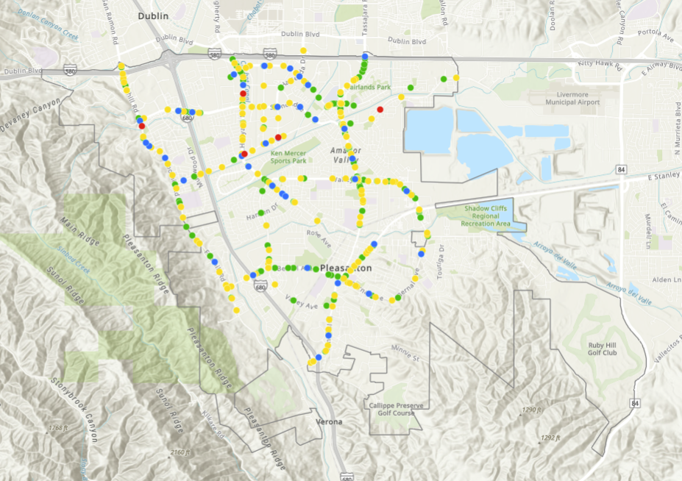

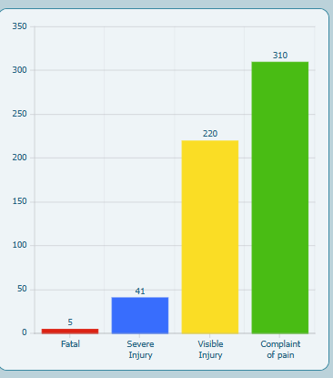
Proposed Safety Projects
The proposed safety projects are well aligned with the City’s ongoing efforts, public input, TAC recommendations, collision analysis, and identified engineering solutions.
These are preliminary projects shortlisted for inclusion in the draft plan, focusing on high-injury corridors where improvements are most needed.
Advancing these projects will position the City to pursue grant funding and other financial resources, enabling implementation as funding becomes available.
Notes:
Sliding window method:

Slide 19
Proposed Safety Projects
No. | Corridor | KSI | Injury | Ped | Bike | Unsafe Speed | Improvements
1 | Santa Rita Road – North City Limits to Rosewood Drive | 5 | 101 | 6 | 25 | 30 | Modify signal phasing to implement a LPI and add left turn phases at key intersections
2 | Santa Rita Road – Stoneridge Drive to Mohr Avenue |  |  |  |  |  | Phase 1: Upgrade from Class 2 buffer bike lane to Class 4 separated by reducing the travel lane. Buffer can be concrete. Phase 2: Extend sidewalks to include 5' bike lanes and make intersections along the segment Protected bike Intersection, include full signal upgrades to meet latest standards
3 | Santa Rita Road - Stoneridge Drive to Rosewood |  |  |  |  |  | Extend sidewalks to include 5' bike lanes and make intersections along the segment Protected bike Intersection, include full signal upgrades to meet latest standards
4 | Santa Rita Road – Mohr Avenue to Valley Avenue |  |  |  |  |  | Phase 1: Upgrade from Class 2 buffer bike lane to Class 4 separated by reducing the travel lane. Buffer can be concrete. Phase 2: Extend sidewalks to include 5' bike lanes and make intersections along the segment Protected bike Intersection, include full signal upgrades to meet latest standards
5 | Santa Rita Road – Valley Avenue to Black Avenue |  |  |  |  |  | Phase 1: Upgrade from Class 2 buffer bike lane to Class 4 separated by reducing the travel lane. Buffer can be concrete. Phase 2 - Elevated Cycle Track with improved sight distances for added safety Francisco to Black Improvements below: Keep Parking SB between Francisco to Black Avenue, guide bikes to the sidewalk path for Amador Valley Community Park and widen that walkway for better bike/pedestrian shared use path. Santa Rita Road & Francisco: Enhance intersection for added bike safety to cross Santa Rita Road
 |  |  |  |  |  |  | Phase 1: Upgrade from Class 2 buffer bike lane to Class 4 separated by reducing the travel lane. Buffer can be concrete. Phase 2 - Elevated Cycle Track with improved sight distances for added safety Francisco to Black Improvements below: Keep Parking SB between Francisco to Black Avenue, guide bikes to the sidewalk path for Amador Valley Community Park and widen that walkway for better bike/pedestrian shared use path. Santa Rita Road & Francisco: Enhance intersection for added bike safety to cross Santa Rita Road
6 | Santa Rita at Valley Avenue |  |  |  |  |  | Phase 1:Intersection safety improvements by Developer project on east side of intersection Phase 2:Improve west side of intersections to enhance overall bike/ped safety at intersection
7 | Santa Rita Road - Black Avenue to Stanley |  |  |  |  |  | Raised Cycle track southbound direction (convert the bike lane to raised in the area) - existing bus stop in front of Post Office to be floating bus stop in travel lane
8 | Downtown Corridor - Ray St to Old Bernal Ave |  |  |  |  |  | Parallel bike facility (cycle track) that diverts on St. John St to Peters Avenue
9 | Overall Corridor Improvement |  |  |  |  |  | Retroreflective backplate - all signalized locations Speed Feedback Signs - at strategic locations Upgrade from Class 2 buffer bike lane to Class 4 facility with bollards or Buffer can be landscape. Speed Cameras at all key intersections.
Notes:
Sliding window method:

Slide 20
Proposed Safety Projects
No. | Corridor | KSI | Injury | Ped | Bike | Unsafe Speed | Improvements
1 | Hopyard Road – W. Las Positas Boulevard to Valley Avenue (3) | 4 | 50 | 1 | 9 | 17 | Signal modifications - all intersections (Countdown Pedestrian Heads and APS Push Buttons) Modify signal phasing to implement protected left turn phases at Parkside/S. Valley Trails Dr Modify signal phasing to implement a LPI - at locations with Pedestrian Collisions at sig. intersections
2 | Hopyard Road – Valley Avenue to Black Avenue (1) |  |  |  |  |  | Advance warning signs and pavement markings. Modify signal phasing to implement protected left turn phases at Parkside/S. Valley Trails Dr (Unsplit eastbound and westbound) Add a second eastbound left turn.
3 | Hopyard Road – Owens Drive to Stoneridge Drive (4) |  |  |  |  |  | Green Pavement Enhancements (GPE) upgrades for existing class II bike lanes at conflict points. Enhance bike lanes to Class IV
4 | Hopyard Road & Stoneridge Drive |  |  |  |  |  | Provide EB free right turn (maybe remove one SB through lane). Change cycle to 100 sec
5 | I-580 to Black Ave |  |  |  |  |  | Speed Feedback Signs. Consider Speed Cameras when applicable
 |  |  |  |  |  |  | Red Light Cameras at all intersections with Traffic Signal Violation Collisions
 |  |  |  |  |  |  | Limit Line upgrades at key intersections
 |  |  |  |  |  |  | Remove pork chop islands (Valley, Los Positas, Parkside, Black(ped safety) - convert to protected bike intersections as feasible Evaluate - Stoneridge & Hopyard for pork chop removal
 |  |  |  |  |  |  | Raised Cycle Track / Shared Use Path (Based on direction)
Notes:
Sliding window method:

Slide 21
Proposed Safety Projects
No. | Corridor | KSI | Injury | Ped | Bike | Unsafe Speed | Improvements
1 | Owens Drive – Hacienda Drive to Willow Road | 3 | 10 | 0 | 5 | 3 | Willow & Owens: Protected Intersections and Road Diet, remove EB/WB right turn lanes and they become thru/right lanes for both approaches, bring in sidewalk/curb extensions 3 corners
 |  |  |  |  |  |  | Upgrade Bike facility to cycle track along Owens (Hacienda to Hopyard)
 |  |  |  |  |  |  | Retroreflective backplates, LPI, Countdown Heads, and APS push buttons
2 | Las Positas - Hopyard Rd to Hacienda Dr | 3 | 8 | 0 | 2 | 2 | Implement school zone traffic calming (e.g., raised crosswalks, Curb Extensions). Remove pork chop islands Red light violation detection units. Class IV - Raised Cycle Track, with landscape physical separators. Tree trimming at intersections for better visibility.
 |  |  |  |  |  |  | Retroreflective backplate.
 |  |  |  |  |  |  | Install object markers on fixed objects
3 | Foothill Road – I-580 NB Off-Ramp to Stoneridge Drive | 4 | 39 | 3 | 0 | 7 | Enhance lighting and signage near curves or school zones.
4 | Foothill Road – Stoneridge Drive to Muirwood Drive |  |  |  |  |  | Upgrade Centerline Striping
5 | Overall Improvement on Foothill Road |  |  |  |  |  | Upgrade High Visibility Crosswalk
 |  |  |  |  |  |  | Physical Divider between bike lane and travel lane with landscape median island, to reduce the speed.
 |  |  |  |  |  |  | Retroreflective backplate.
 |  |  |  |  |  |  | ATS push button upgrades.
 |  |  |  |  |  |  | Countdown signal heads
 |  |  |  |  |  |  | Install object markers on fixed objects
 |  |  |  |  |  |  | Limit Line upgrade
Notes:
Sliding window method:

Slide 22
Proposed Safety Projects
No. | Corridor | KSI | Injury | Ped | Bike | Unsafe Speed | Improvements
1 | Sunol Boulevard – Sonoma Drive to I-680 SB Off-Ramp | 3 | 39 | 0 | 1 | 3 | Improve curve delineation with chevrons and reflective markers.
 |  |  |  |  |  |  | Raised Cycle track at I-680 Interchange and a Class IV Separated Bike Lanes to Arlington Dr afterwards
 |  |  |  |  |  |  | Sunol Boulevard I-680 Interchange Widen roadway in interchange area; signalize both ramp intersections at Sunol Boulevard; widen structure over Happy Valley Road and provide a southbound acceleration lane from Sunol On-Ramp
 |  |  |  |  |  |  | Retroreflective backplates (sycamore road and sunol) Red light camera, tree trimming for better signal head visibility
2 | Valley Avenue – Crestline Road to Santa Rita Road | 1 | 9 | 1 | 1 | 4 | Implement school zone traffic calming (e.g., flashing beacons) and speed feedback signs
 |  |  |  |  |  |  | Remove right turn lanes at Crestline Road and Greenwood to reduce crossing distance along Valley to enhance pedestrian crossing safety
 |  |  |  |  |  |  | Greenwood Signal Improvements - Retroreflective backplate, add countdown heads if not already done, already has APS push buttons
 |  |  |  |  |  |  | Limit lines at intersections, advance warning signs and pavement markings upgrades for added safety
 |  |  |  |  |  |  | Raised Cycle Track / Shared Use Path (Based on direction)
3 | Bernal Avenue – Valley Avenue to Pleasanton Avenue | 1 | 11 | 2 | 1 | 5 | Enhance signals at Valley & Pleasanton to have retroreflective backplates, countdown heads, APS push buttons and LPI (Pleasanton - Verify feasibility)
 |  |  |  |  |  |  | Class IV (Buffer with Bollards) bike lane east of Valley Avenue (remove existing right turn lane)
 |  |  |  |  |  |  | Interim - Class IV (Buffer with Bollards) - Ultimate raised Bike Lane westbound Valley Ave to Pleasanton Ave
4 | Bernal Avenue – Sunol Boulevard to Windmill Way | 1 | 6 | 1 | 3 | 2 | Bernal/Sunol/First - Protected bike intersection upgrade
 |  |  |  |  |  |  | Advance warning signs and pavement markings for added pedestrian safety
 |  |  |  |  |  |  | Class IV (buffer with bollards) - interim, consider landscape separation as ultimate design
 |  |  |  |  |  |  | Upgrade to High Visibility Crosswalks and Advance Yield Markings for Pedestrian Safety
Notes:
Sliding window method:

Slide 23
Proposed Citywide Safety Projects
No. | Corridor | KSI | All Collisions | Notes
1 | Signal Upgrades | 67 | 809 | Signal upgrades will modernize existing traffic signals through improved timing, technology enhancements, and accessibility features. These improvements aim to enhance traffic flow, reduce conflicts, and improve safety for pedestrians, bicyclists, and drivers.
2 | Feasibility Study for Leading Pedestrian Interval (LPI) |  |  | This study will evaluate intersections where Leading Pedestrian Intervals can be implemented to give pedestrians a head start before vehicles receive a green signal. LPIs are a proven safety countermeasure that can reduce pedestrian-vehicle conflicts, especially at high-volume intersections.
3 | Sign Inventory |  |  | The sign inventory will assess the condition, visibility, and compliance of existing traffic signs citywide. This will help identify missing, outdated, or ineffective signage and support improvements that enhance roadway clarity and safety for all users.
4 | Feasibility Study for Bike Lane – Upgrades |  |  | This effort will evaluate existing bike facilities to identify opportunities for upgrades, such as transitioning to protected or buffered bike lanes. The goal is to enhance safety for bicyclists, particularly along high-injury corridors and key commuting routes.
5 | Updating the Neighborhood Traffic Calming Program |  |  | This program focuses on addressing localized traffic concerns such as speeding and cut-through traffic in residential areas. It provides a structured, community-driven approach to evaluate and implement traffic calming measures that improve neighborhood safety.
6 | Circulation Study Near Schools |  |  | The circulation study will analyze traffic patterns, multimodal connectivity, and roadway operations across key corridors. The goal is to identify opportunities to improve mobility, reduce congestion, and enhance safety for all modes of transportation.
7 | Citywide Speed Reduction Strategy/Safe System Speed Reduction Program |  |  | The Safe Speeds Initiative is a citywide program focused on reducing unsafe driving speeds through roadway design improvements, traffic calming measures, targeted enforcement, and public awareness strategies to improve safety for all users.
8 | Dashboard |  |  | A citywide safety dashboard will be developed to track key performance metrics, monitor project implementation, and provide transparent, data-driven insights into transportation safety improvements over time.
Notes:
Sliding window method:

Slide 24
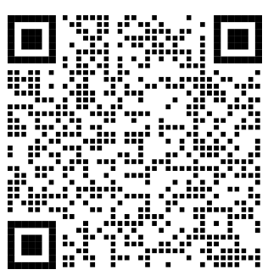

Your Role as a Safety Champion
Pleasantontransportationsafety.com
Participate in outreach: Attend future public meetings to provide input and stay informed.
Report safety concerns: Share locations with speeding, near-misses, or unsafe crossings so improvements can be prioritized.
Practice safe behavior: Follow speed limits, yield to pedestrians, and encourage responsible driving, biking, and walking.
Partner with local agencies: Schools, businesses, and community groups can help promote education and awareness programs.
Advocate for improvements: Support funding and policies that prioritize safer streets and infrastructure.
Be a role model: Demonstrate safe travel behavior and encourage others to do the same.
Contents
Project timeline
FAQs
Project documents
Collision History
Upcoming community meetings
Website
Feedback Opportunities
Virtual meeting
Share Concerns
Ask Questions
Provide Feedback
Sign up to stay informed
Community Meeting
May 7th
Notes:
Rosanna
Project Website is on the City of Arcata and provides information on the progress of the Plans and links to the interactive map and survey.
We have an interactive map which we will do a quick demonstration of later, where you can put comments on a specific location, and a Survey we’d like you all to take that asks about your travel in Arcata and improvements you’d like to see.

Slide 25
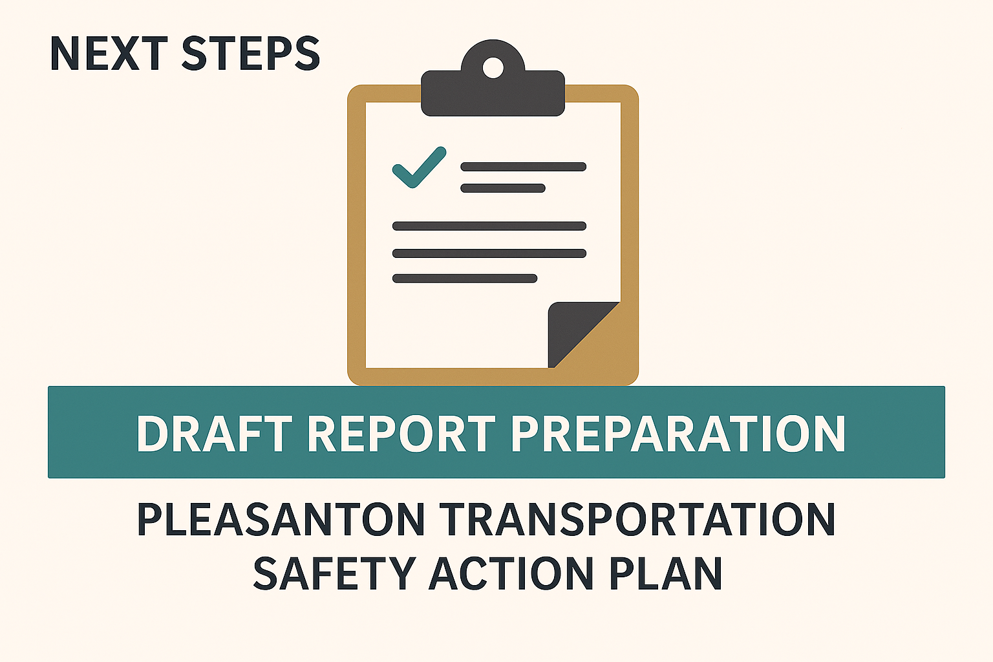
Next Steps
Finalize Safety Projects.
Conduct fourth round of Stakeholder and Community meetings to gather additional feedback and comments.

Slide 26
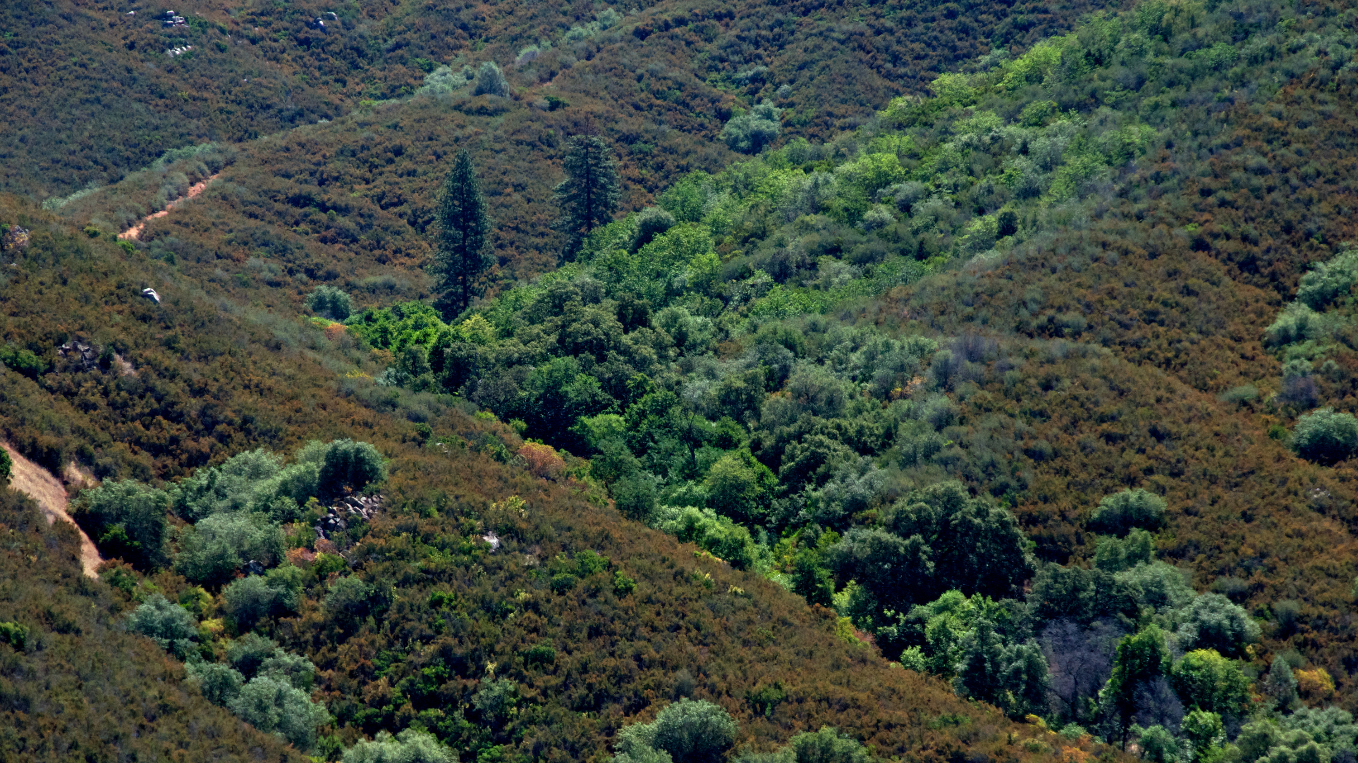
Discussion/Questions

Slide 27
Thank you!

